Slide 1



E–commerce platform with product recommendation engine
Guided by:
Dr.K.Jayasakthi Velmurugan
COURSE FACULTY
Department of Deep Learning.
Saveetha School of Engineering,SIMATS, Chennai - 602105
Done by:
Supraja G D
192225024

Slide 2
Agenda
1.Introduction
2.Objective
3.Exixting system
4.Proposed system
5.Architecture diagram
6.Listed modules
7.Output screenshot
8.Conclusion
9.References

Slide 3
Introduction
The E-Commerce Platform for Product Recommendation project focuses on building a scalable, intelligent recommendation system that leverages user behavior, preferences, and historical data to provide personalized product suggestions. By integrating cutting-edge algorithms like collaborative filtering, content-based filtering, and hybrid methods, the platform aims to create a seamless and engaging shopping experience.

Slide 4
Objective
To develop an efficient and scalable product recommendation system for an e-commerce platform that enhances user experience by providing personalized recommendations, increasing customer satisfaction, and driving sales.

Slide 5
Existing System and Its Drawbacks
Existing System:
Standard e-commerce systems with static or rule-based product recommendations.
Drawbacks:
Lack of personalization
Recommendations may not match user interests or preferences
Cold-start problem for new users
Poor scalability with growing data

Slide 6
Proposed System and Its Advantages
Proposed System:
Use of collaborative filtering, content-based filtering, and hybrid recommendation techniques to provide real-time, personalized product suggestions.
Advantages:
Personalized recommendations based on user behavior
Solves the cold-start problem using hybrid techniques
Scalable solution that adapts to user and product growth
Increased user engagement and conversion rates

Slide 7
Architecture Diagram
+-------------------------+ +--------------------------+ +-------------------------+
| User Interface | ---> | Backend Services | ---> | Recommendation Engine |
| - Search & Display | | - Product & Order Mgmt | |- Data Collection & ML |
+-------------------------+ +--------------------------+ +-------------------------+
| |
v v
+-------------------------+ +--------------------------+ +-------------------------+
| Data Layer | ---> | External Integrations | ---> | Security & Privacy |
| - User & Product Data | | - Payments & Shipping | | - Encryption & Control |
+-------------------------+ +--------------------------+ +-------------------------+

Slide 8
Listed Modules
Data Collection and Tracking
Recommendation Engine
Product Catalog
User Profiles
A/B Testing

Slide 9
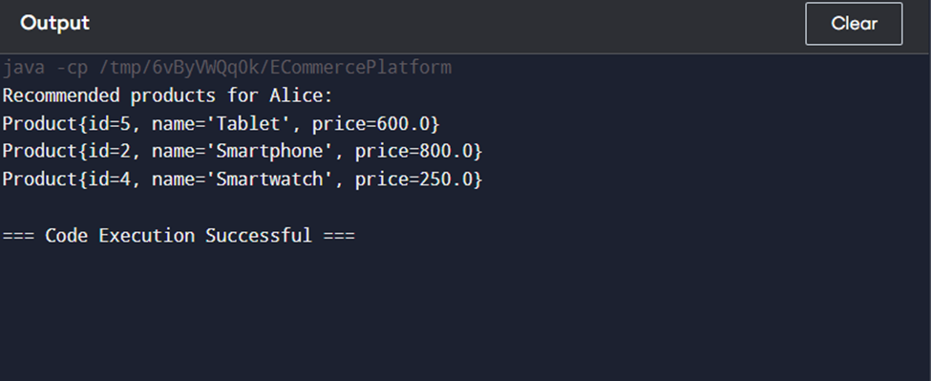
Output Screenshot

Slide 10
Conclusion and Future Enhancement
Conclusion:
The proposed system addresses the limitations of existing recommendation systems by offering personalized, scalable, and real-time recommendations.
Future Enhancements:
Integrating more advanced AI techniques like deep learning
Improving the cold-start problem for new users further
Enhancing the recommendation engine to work across multiple devices seamlessly

Slide 11
References
Ricci, F., Rokach, L., & Shapira, B. (2011). Introduction to Recommender Systems Handbook. Springer.
Aggarwal, C. C. (2016). Recommender Systems: The Textbook. Springer.
Smith, A., & Linden, G. (2017). Two Decades of Recommender Systems at Amazon.com. IEEE Internet Computing, 21(3), 12-18.
chafer, J. B., Konstan, J., & Riedl, J. (1999). Recommender Systems in E-Commerce. In Proceedings of the 1st ACM Conference on Electronic Commerce (pp. 158-166). ACM.
Adomavicius, G., & Tuzhilin, A. (2005). Toward the Next Generation of Recommender Systems: A Survey of the State-of-the-Art and Possible Extensions. IEEE Transactions on Knowledge and Data Engineering, 17(6), 734-749.
Koren, Y., Bell, R., & Volinsky, C. (2009). Matrix Factorization Techniques for Recommender Systems. IEEE Computer, 42(8), 30-37.

